Slide 1
DYNAMIC CONCEALMENT IN RECITAL VISUAL BLOCKCHAIN USING WEB APPLICATION
NAME: S.GOPINATH
Dept.No: 18-PCA-025

Slide 2
Description of the problem
Block chain
Ripple
xRapid
xCurrent
XRP Server

Slide 3
Objective
Customers will register with the User Id and Password.
To know the status of the Account.
Remind the customers about the information through the notification
Know the details of the previous transaction.
Update the upcoming schedule.
Provides high authentication and data security.

Slide 4
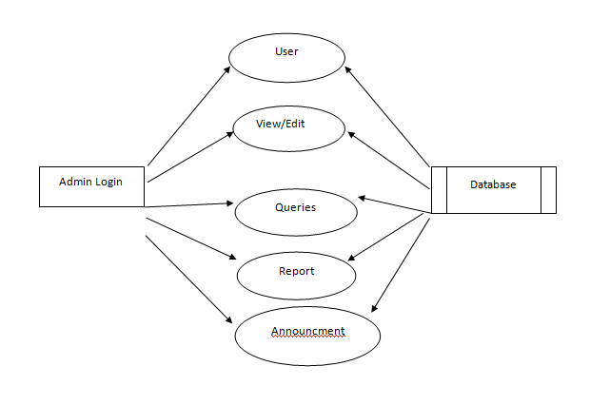
Data flow Diagram

Slide 5
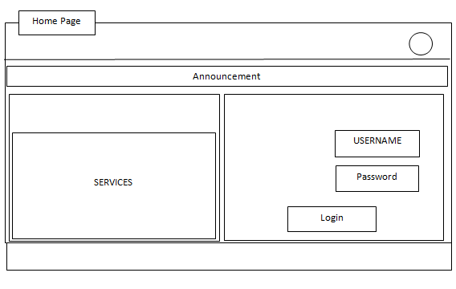
Pseudo Form Design Home Page

Slide 6
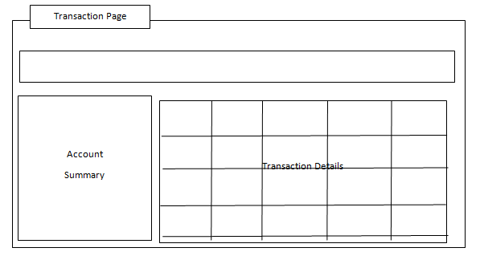
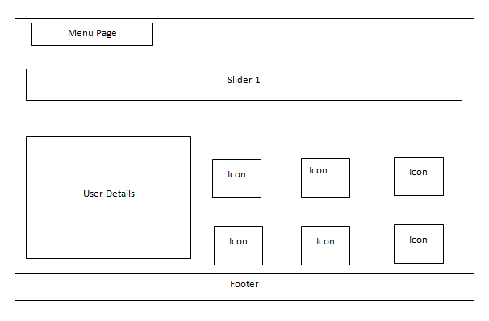

Slide 7
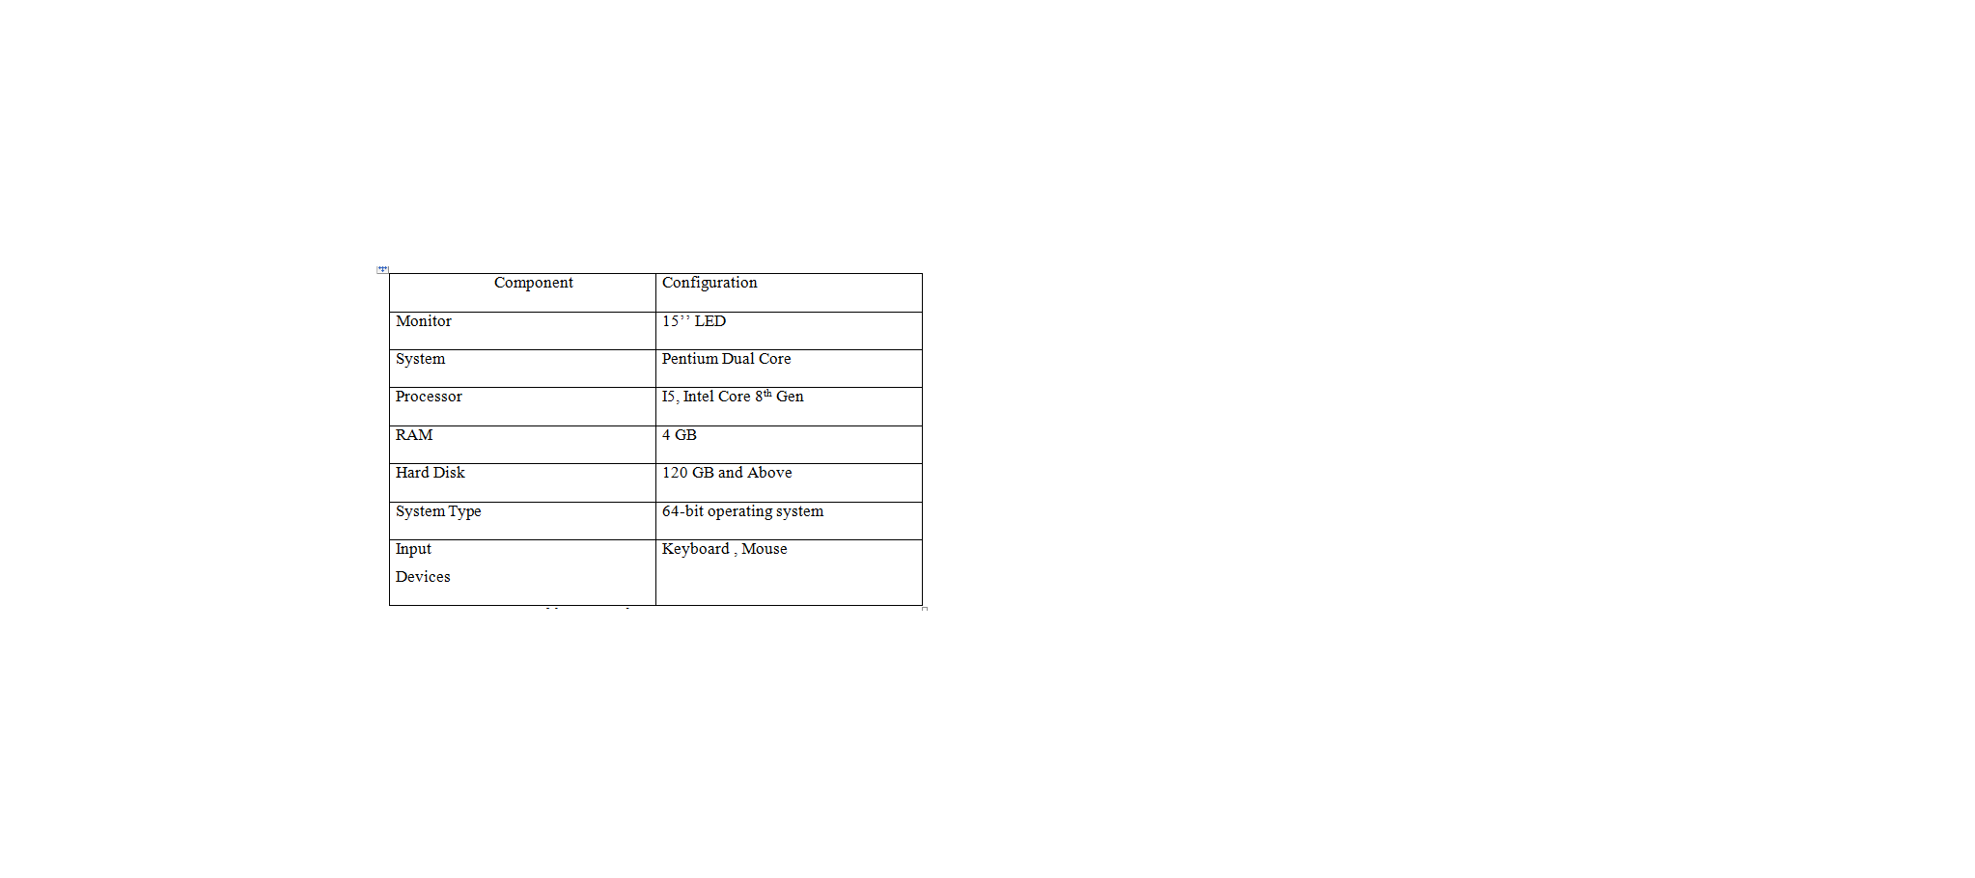
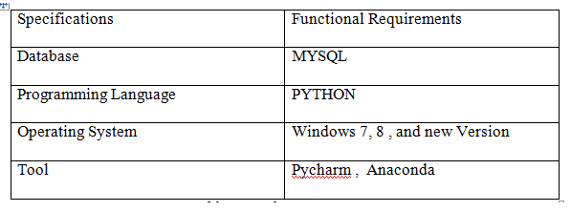
HARDWARE AND SOFTWARE REQUIREMENT

Slide 8
Testing Strategies
All field entries must work properly
Ensure database is maintained with integrity and confidential
The entry screen, messages and responses must be validated
Validation of input has been done
No duplicate entries should be allowed
All links should take the user to the correct page .
Unit Testing
Integration Testing
Database Testing

Slide 9
Integration Testing
S.No | Module Name | Test Condition | Expected Result | Actual Result
1 | Login page | Click on login button after entering valid input data | Navigate to the Alternate Page | Navigate to the Alternate Page
2 | Account page | Account details must be displayed with all the updates . | Navigate to the Account task activity | Navigate to the Account task activity
3 | Data Records | Click on display button for the details of previous Transaction | Previous details should be displayed. | Previous details should be displayed in the page.
4 | Help Desk | Email is received from the user and should clear the solution. | The FAQS must be clarified by the admin and should be updated soon | The FAQS must be clarified by the admin and should be updated soon.

Slide 10



Technical Documentation
Phycharm
Mysql
Anaconda

Slide 11
User Documentation
User documentation needs to be consistent, simple and have a thorough index.
It enables a user to understand the user interface better. It enables user to understand the Graphical User Interface (GUI) better.
The user is the most important subtasks of the developer.

Slide 12
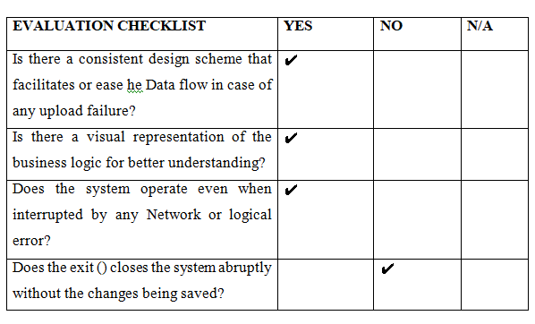
Evaluation checklist

Slide 13
Future enhancements
• Automation in sending important mails and information
• Adding more functionality for user management phase.
• Adding live Updates and Schemes.
• Data Records can be encrypted.

Slide 14
Technical skills learned
• I have learned the concepts of Python.
• I have learned basic concepts of mysql.
• I have experienced working in a real time project which helped me get exposed to
• Different factors that play a main role in IT sector. I have also learnt how to interact with senior employees through reports which is
• A key source of communication within a working environment.
• I have learned how to access sql with Blockchain Technology.

Slide 15
THANK YOU

